Slide 1
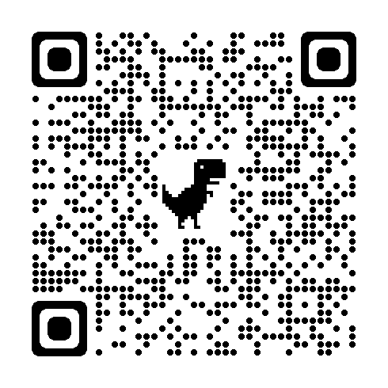
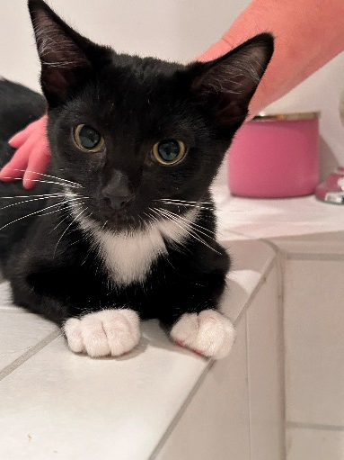
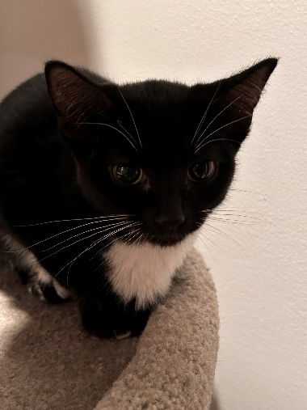
Breed: Domestic Short Hair
DOB: 6/18/2024
Age: 4 Months
Genders: Hooie (Male) : Zooie (Female)
Colors: Black/white
Size: Hooie (4.0 Lbs) : Zooie (4.0 Lbs)
Spayed/Neutered : Yes
Declawed: No
Intake Date: 06/03/2024
Vaccinations* : Rabies, Feline Distemper
Certain medical treatments are common for rescue and shelter animals and these may include administering de-wormers as well as flea/mite treatments/preventatives/other while in our care.
Adoption Price : $375.00** single kitten OR
$350.00** per kitten (2 or more)
(** Includes tax)
Hooie
Confident & Affectionate
Zooie
Confident & Playful
The Ooie’s were born in captivity at Hero’s Heart Headquarters in Grand Rapids, MN to their mother Prooie. Their mother Prooie was a rescue cat from Bowstring Lake.
They are both full of energy - Very playful and friendly, will sit, lay and sleep with you. Beautiful Tuxedo coats. Zooie is a confident girl who has a granny type voice. Hooie is a confident boy who is very affectionate.
They can be adopted individually, but would be even better as a pair. They have been in a foster home with their mother and other foster cats and get along with everyone. They will require kitten food until 12 months old.

