Slide 1
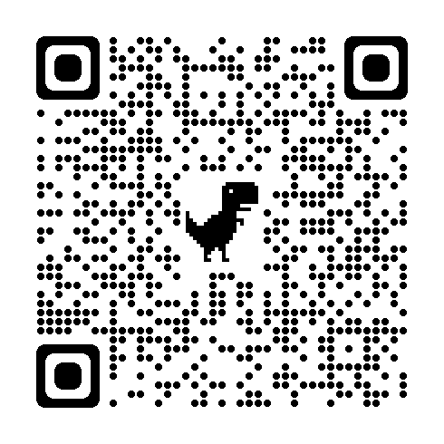
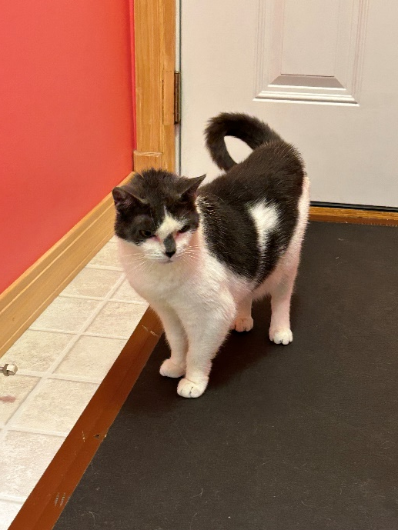
Susie Sweetheart with a curly Q tail
Breed : Domestic Short Hair
DOB: 5/2016
Age : 8 Years
Gender : Female
Size : 8.30 Lbs
Color : Grey/White
Spayed/Neutered : Yes
Declawed: No
Intake Date: 5/24/2024
Vaccinations* : Rabies, Feline Distemper/PRC, Snap 3
* Certain medical treatments are common for rescue and shelter animals and these may include administering de-wormers as well as flea/mite treatments/preventatives/other while in our care
Adoption Price : $225.00 (Includes tax)
Susie is originally from Meadowlands area, MN. Unfortunately her owner passed away and a relative stepped up to take her in their home, but she was unable to live with their existing dogs. The relative surrendered her to Hero’s Heart rescue knowing they couldn’t give her the home she needed.
Susie is a sweetheart! She loves people, petting, and can be held. She has been treated for Ceruminous Cystomatosis, a condition where cysts form in the ears. The cysts have been removed and should not return, but there is always a small possibility that they could, something that will need to be checked at her yearly vet visits. No other treatment should be needed. She has been in a foster home with other cats, and tolerates everyone, but generally keeps to herself. She will search out people for companionship. No special diet requirements.

