Slide 1
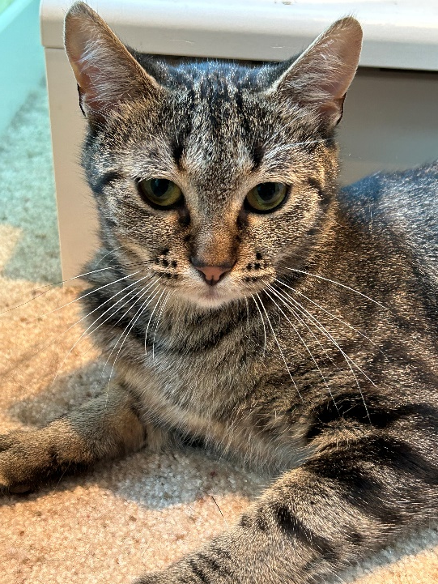
Aurora Sweet and Petite
Breed : Domestic Short Hair
DOB: 6/2022
Age : 2 Years
Gender : Female
Size : 7.20 Lbs
Color : Grey Tabby
Spayed/Neutered : Yes
Declawed: No
Intake Date: 6/27/2024
Vaccinations* : Rabies, Feline Distemper, Snap 3
* Certain medical treatments are common for rescue and shelter animals and these may include administering de-wormers as well as flea/mite treatments/preventatives/other while in our care
Adoption Price : 300.00 (Includes tax)
Aurora was found as a stray with her 3 babies that she had recently given birth to in the Cohasset, MN area. Hero’s Heart Rescue took her and her babies in and eventually transferred them into a foster home. We are happy to report that her 3 babies were adopted together by a single household.
Aurora is a little sweetheart! She is very petite. She loves to play and she is very social. She loves to be petted and can be held on her own terms. She has been in a foster home with other cats, and gets along with everyone. She is very good with kittens, and has been a very good substitute mother for other kittens in the foster group. She settled into our foster home immediately and should adjust to her forever home quickly. No special diet requirements.

