Slide 1
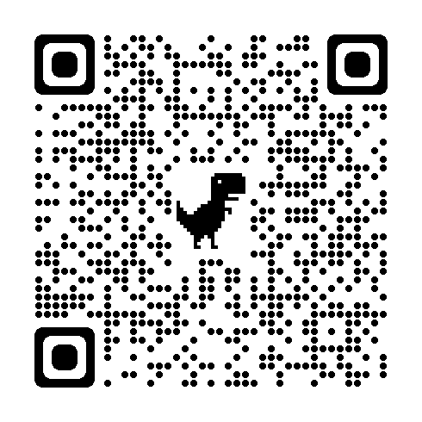
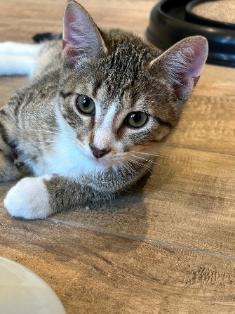
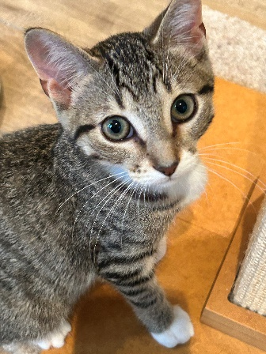
Breed : Domestic Short Hair Mix
DOB: 4/10/2024
Age : 7 months
Gender : Rowdy (Male) : Ruffian (Male)
Size : 7.8 Lbs (Rowdy), 8.0 lbs (Ruffian)
Color : Brown/White Tabby
Spayed/Neutered : Yes
Declawed: No
Intake Date: 5/5/2024
Vaccinations* : Rabies
* Certain medical treatments are common for rescue and shelter animals and these may include administering de-wormers as well as flea/mite treatments/preventatives/other while in our care
Adoption Price : $500.00 pair (Includes tax) OR
$300.00 single kitten (includes tax)
Rowdy
Friendly & Sweet
Orange Collar
Ruffian
Shy & Playful
Blue Collar
These two were strays from the Big Fork area that were found living together with their family of 5 in a shed and were surrendered to Hero’s Heart along with their mom. They were transferred into a foster home and have been preparing for the store.
Both Rowdy and Ruffian are very sweet kittens. Rowdy is a friendly boy and Ruffian is on the shy side and would do better with his brother. They both warmed up to us while living in our foster home and will warm up in their forever home in time. We would prefer to adopt as a pair but they would each do fine on their own or with existing cats. Their diet requirements at this time should be kitten food until they are 12 months old.

